Slide 1
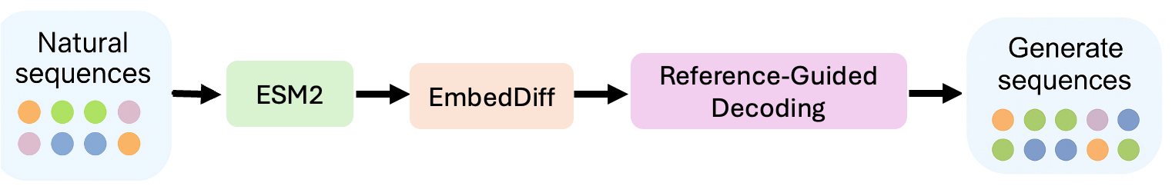
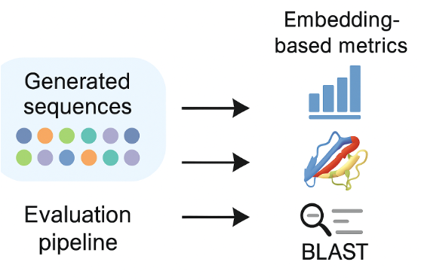
Figure 1. Schematic of the EmbedDiff pipeline for structure-informed protein generation. The pipeline begins by embedding natural protein sequences using the pretrained ESM2 language model, producing fixed-length latent vectors. These embeddings are used to train a denoising diffusion model that learns to reverse Gaussian noise in latent space using a lightweight MLP. During inference, random noise vectors are iteratively denoised to generate novel protein embeddings. Generated embeddings are decoded into amino acid sequences using an autoregressive Transformer decoder. Decoding is performed via a hybrid sampling scheme that probabilistically mixes between model predictions and residues from the most similar reference sequence. Output sequences are filtered based on entropy and percent identity to maintain diversity and biological realism. Structural plausibility is evaluated using ESMFold to ensure foldable, novel sequences across protein families.
Figure 1b. Evaluation pipeline for EmbedDiff-generated protein sequences. After decoding, generated protein sequences are assessed using a multi-faceted evaluation pipeline. This includes: (1) embedding-based similarity metrics (e.g., cosine similarity and t-SNE in ESM2 latent space) to quantify proximity to natural sequences; (2) structure-based evaluation using models like ESMFold to predict 3D folds and derive per-residue confidence scores (e.g., pLDDT); and (3) sequence-level comparison against known proteins using BLAST, enabling detection of homologous or novel variants. This integrative evaluation framework helps assess fidelity, diversity, and structural plausibility of generated proteins.

Slide 2
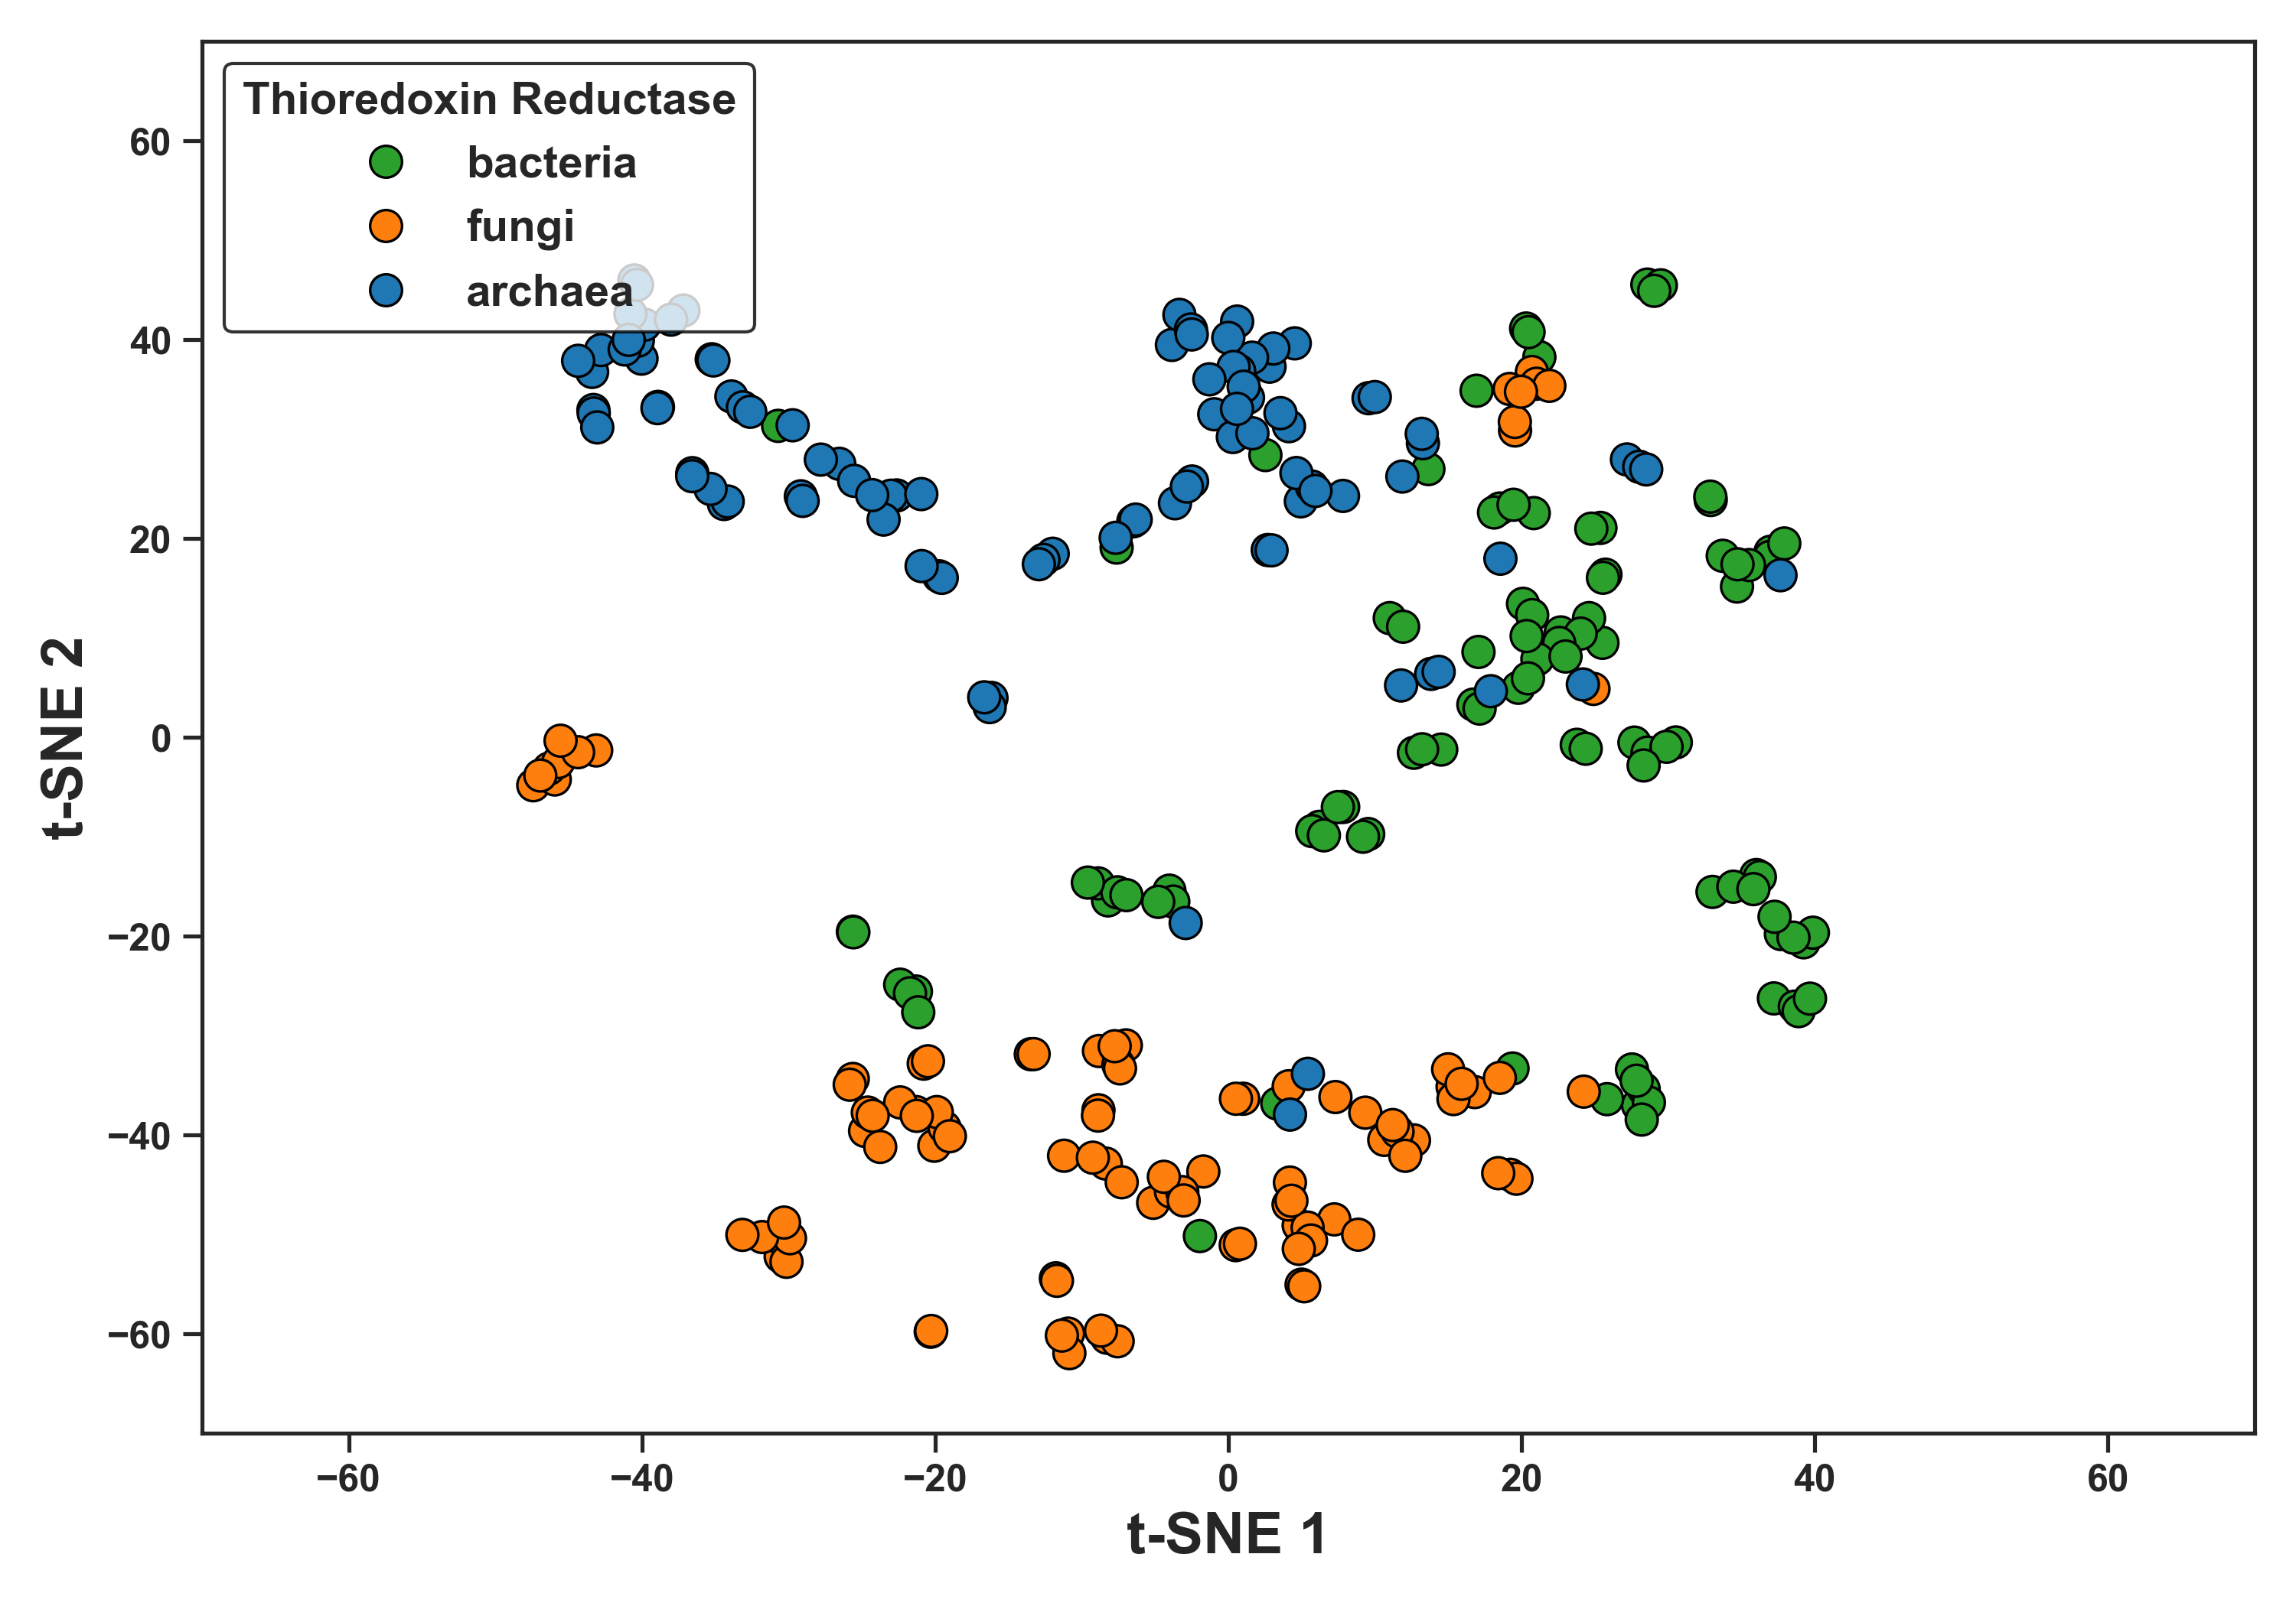
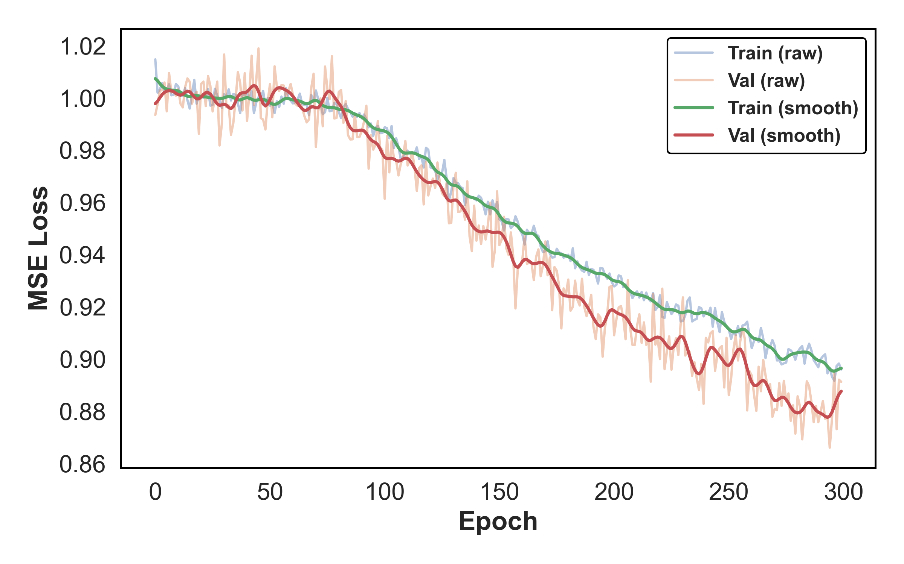
Figure 2a. t-SNE projection of ESM2 embeddings colored by protein class. Natural protein sequences from three taxonomic groups—bacteria, fungi, and archaea—were embedded using the ESM2 language model and visualized using t-distributed stochastic neighbor embedding (t-SNE). Each point represents a single sequence, colored by its associated protein class. The observed clustering suggests that ESM2 embeddings capture meaningful class-specific features, providing a biologically grounded latent space for downstream generative modeling in EmbedDiff.
Figure 2b. Training and validation loss curves for the StructDiff denoising model. Mean squared error (MSE) loss is plotted over 300 training epochs for both the training set (blue) and validation set (orange). The raw loss curves are shown with light colors, while smoothed curves using a Gaussian filter are overlaid for clarity (green and red). The consistent downward trend across both sets indicates stable learning dynamics and effective noise denoising within the ESM2 embedding space. The StructDiff model learns to accurately reconstruct clean protein embeddings from noisy inputs, forming the basis for realistic generative sampling during inference. This training trajectory validates the suitability of diffusion modeling in latent protein space for structure-aware sequence generation.

Slide 3
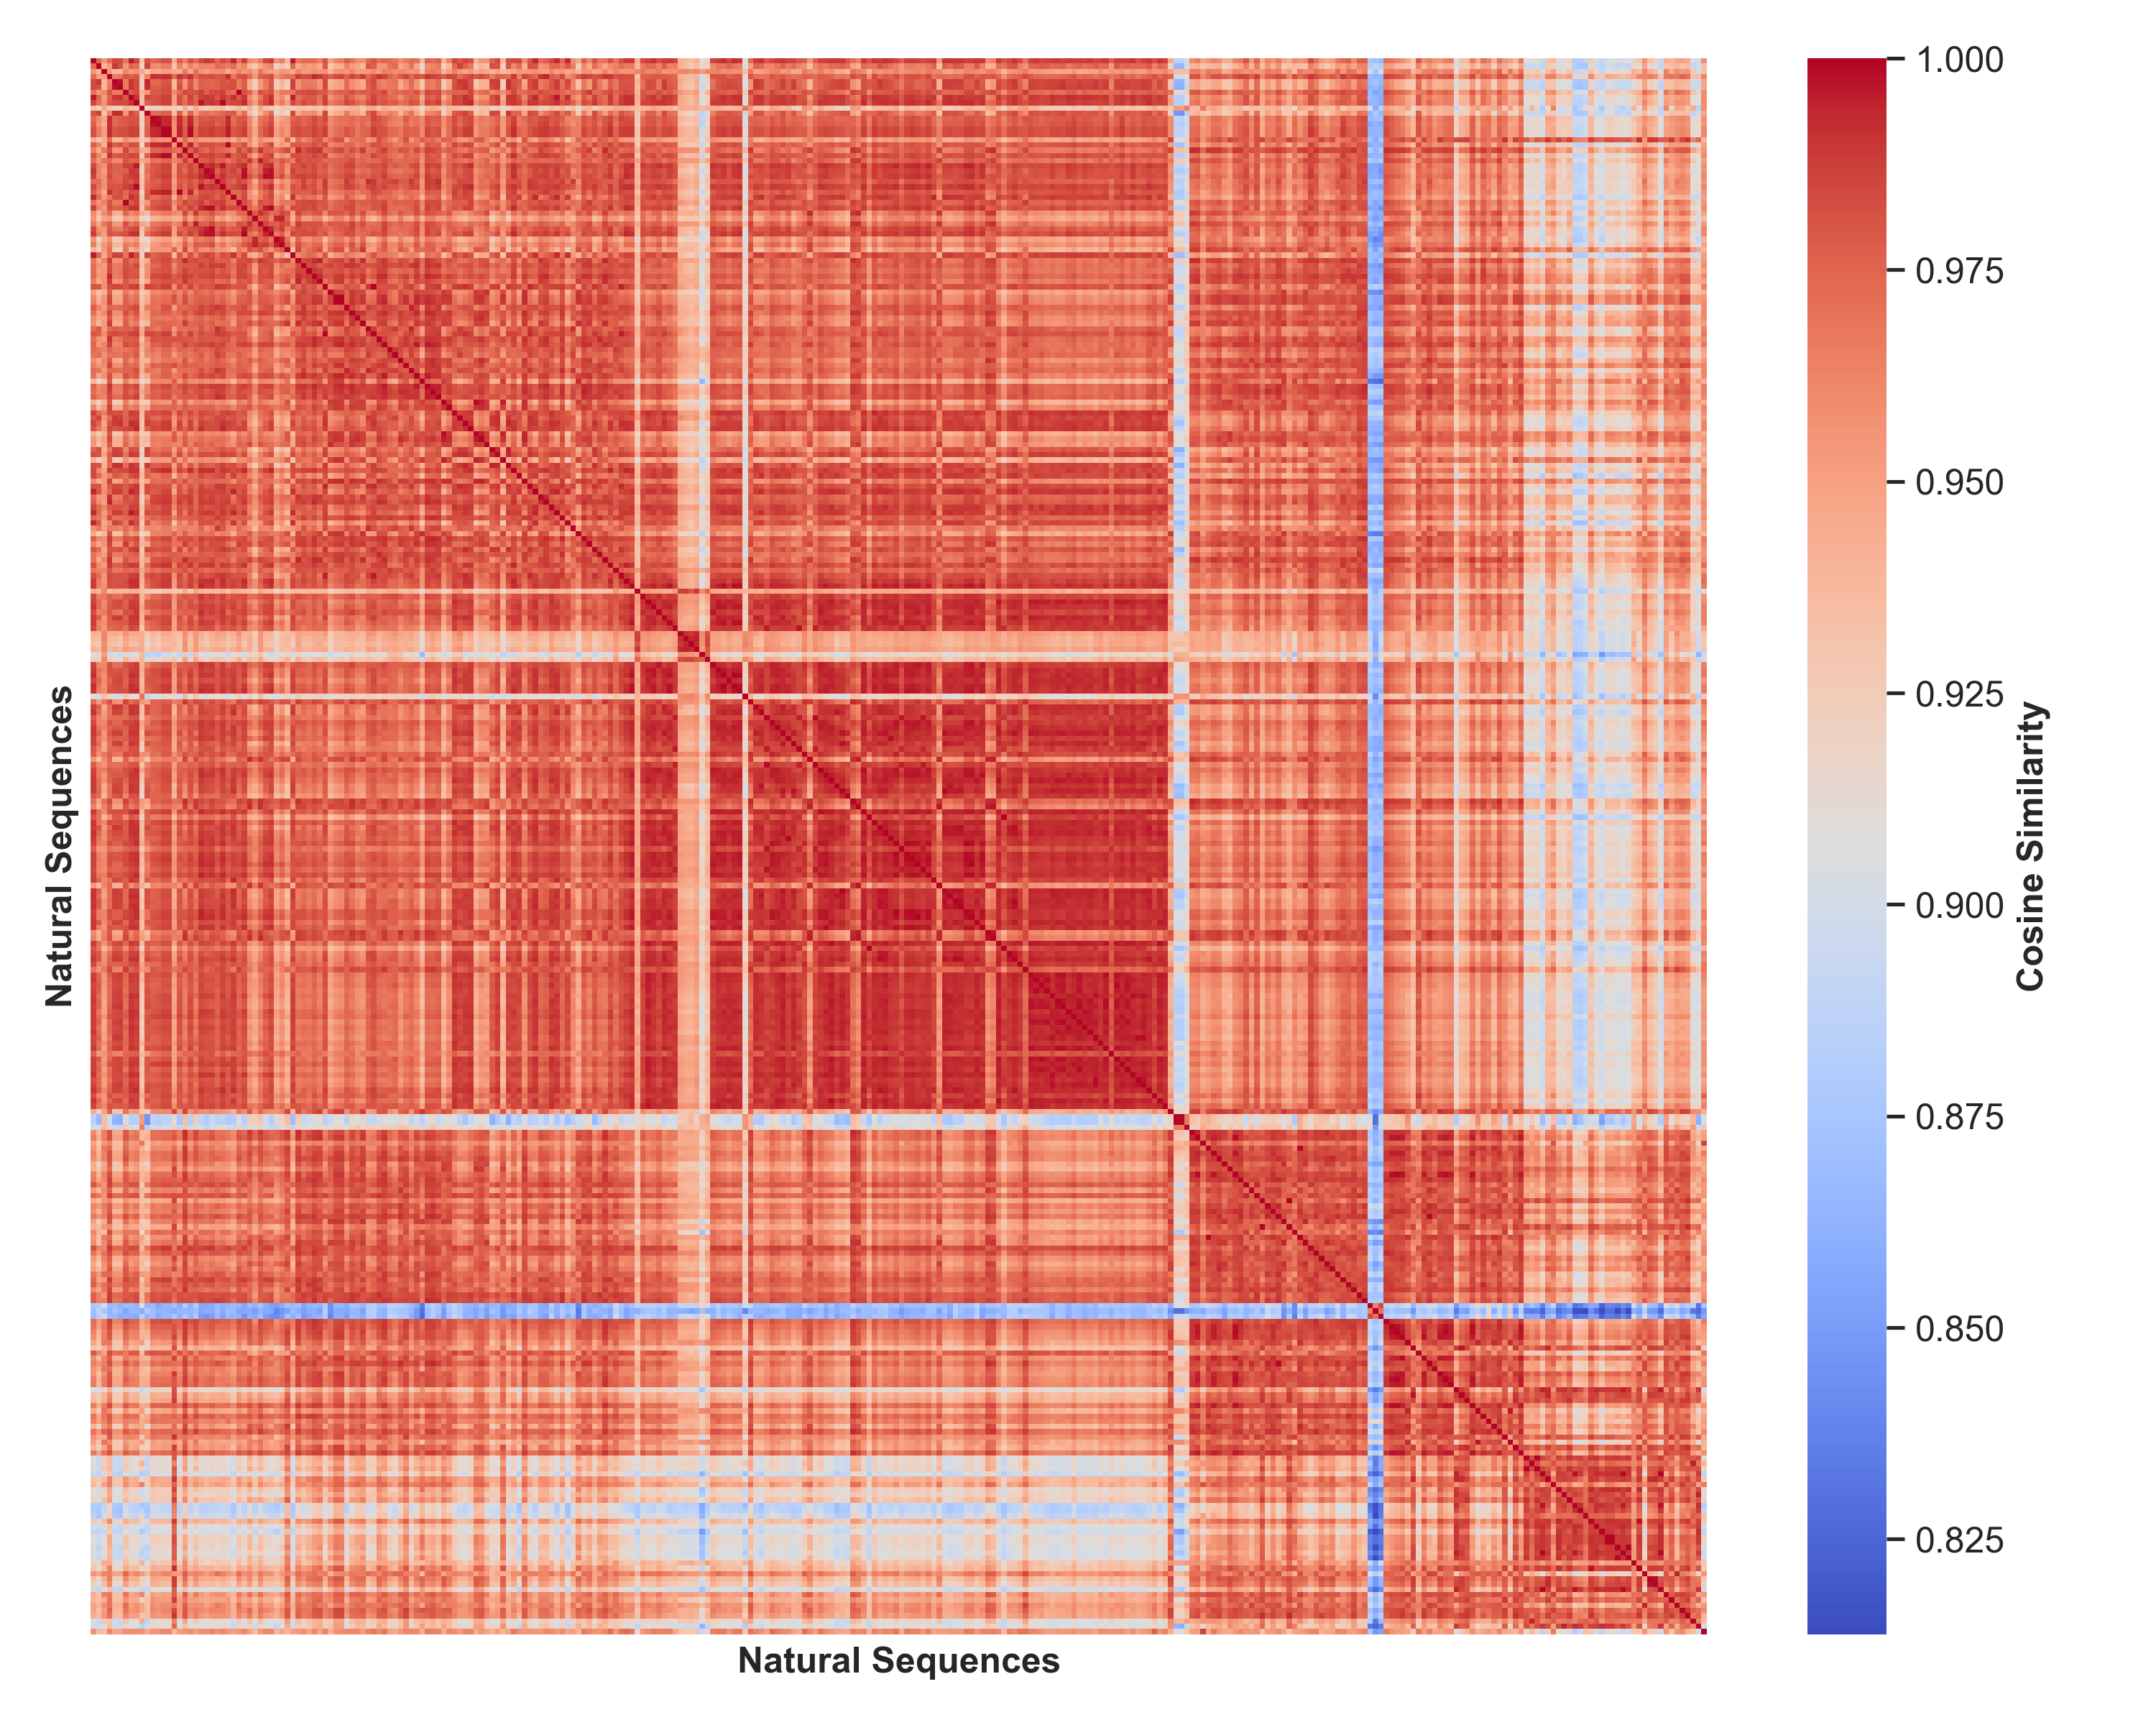
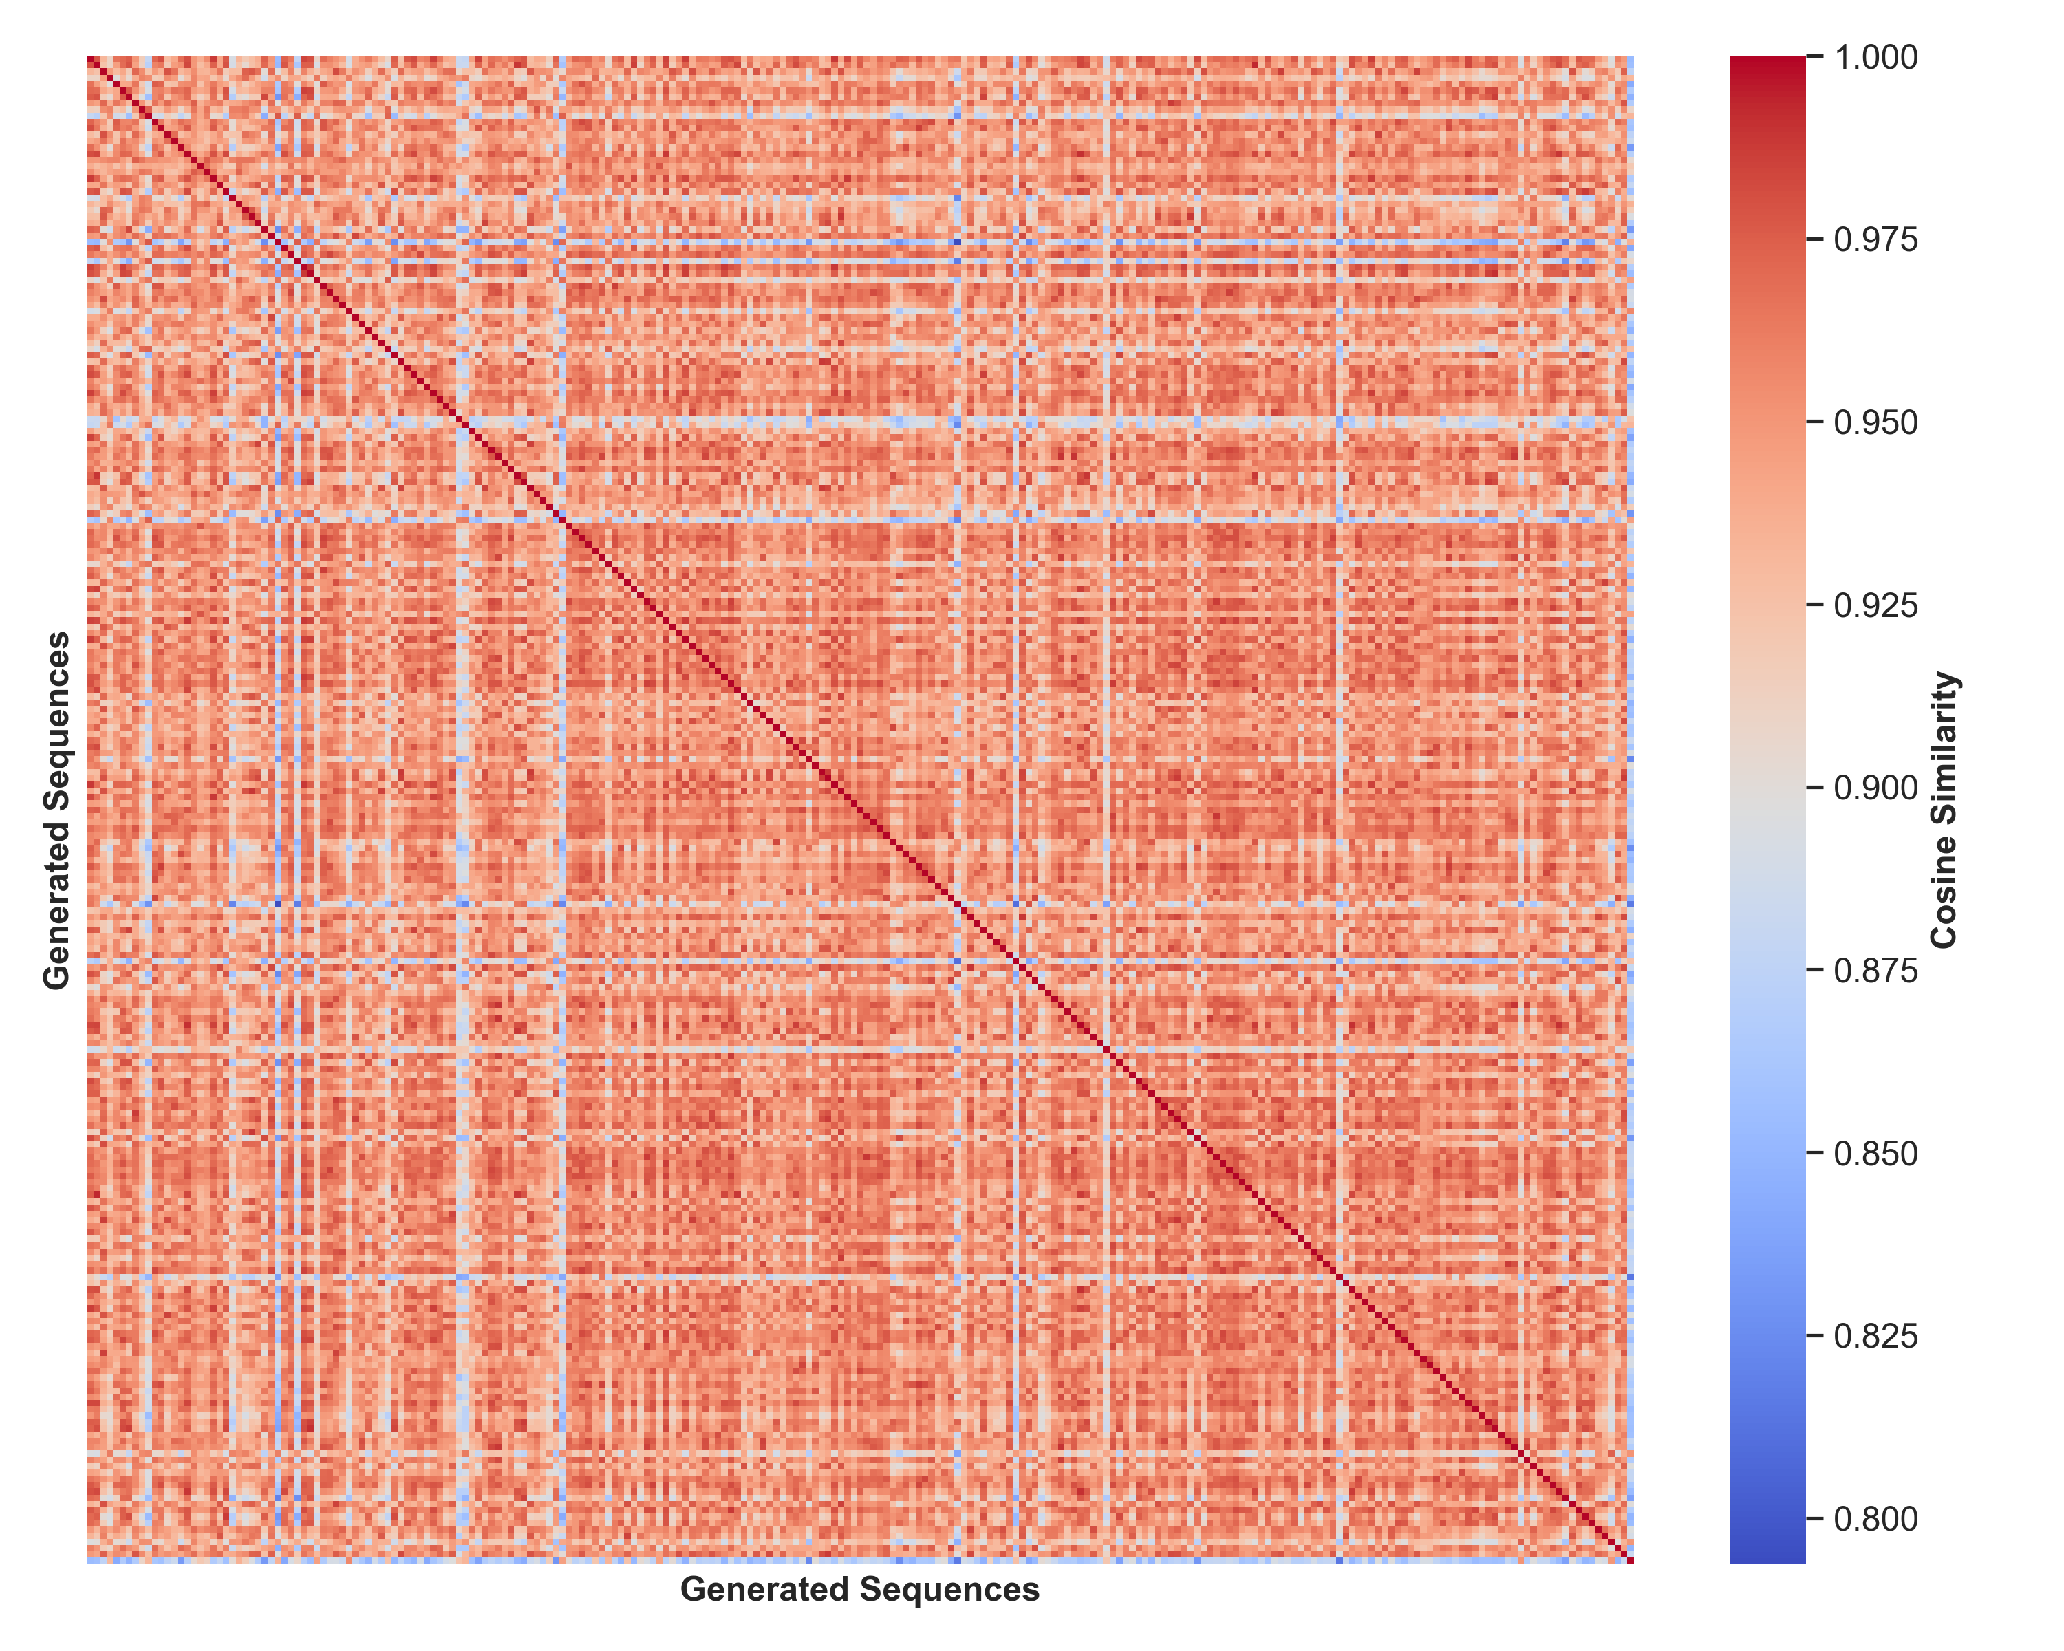
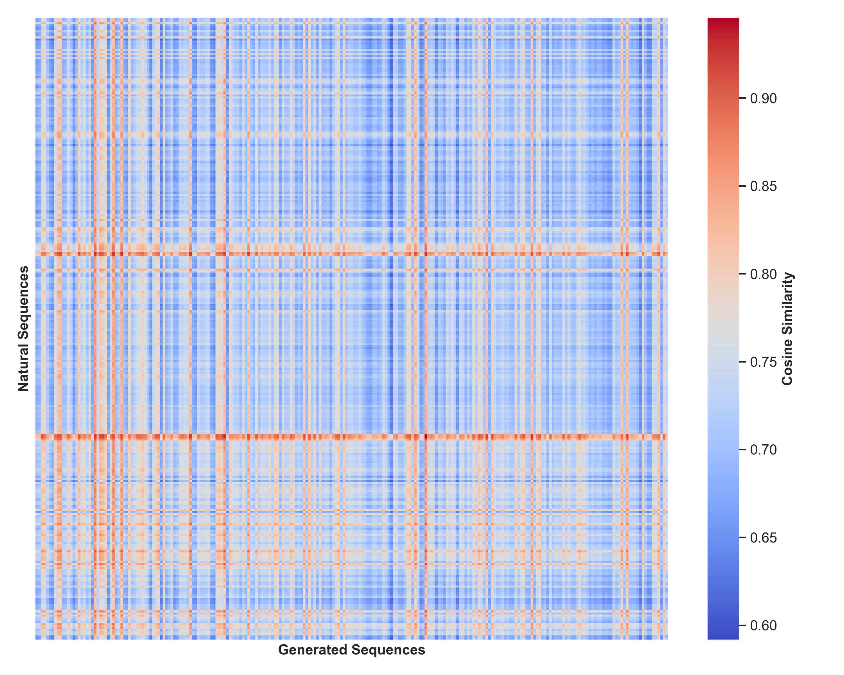
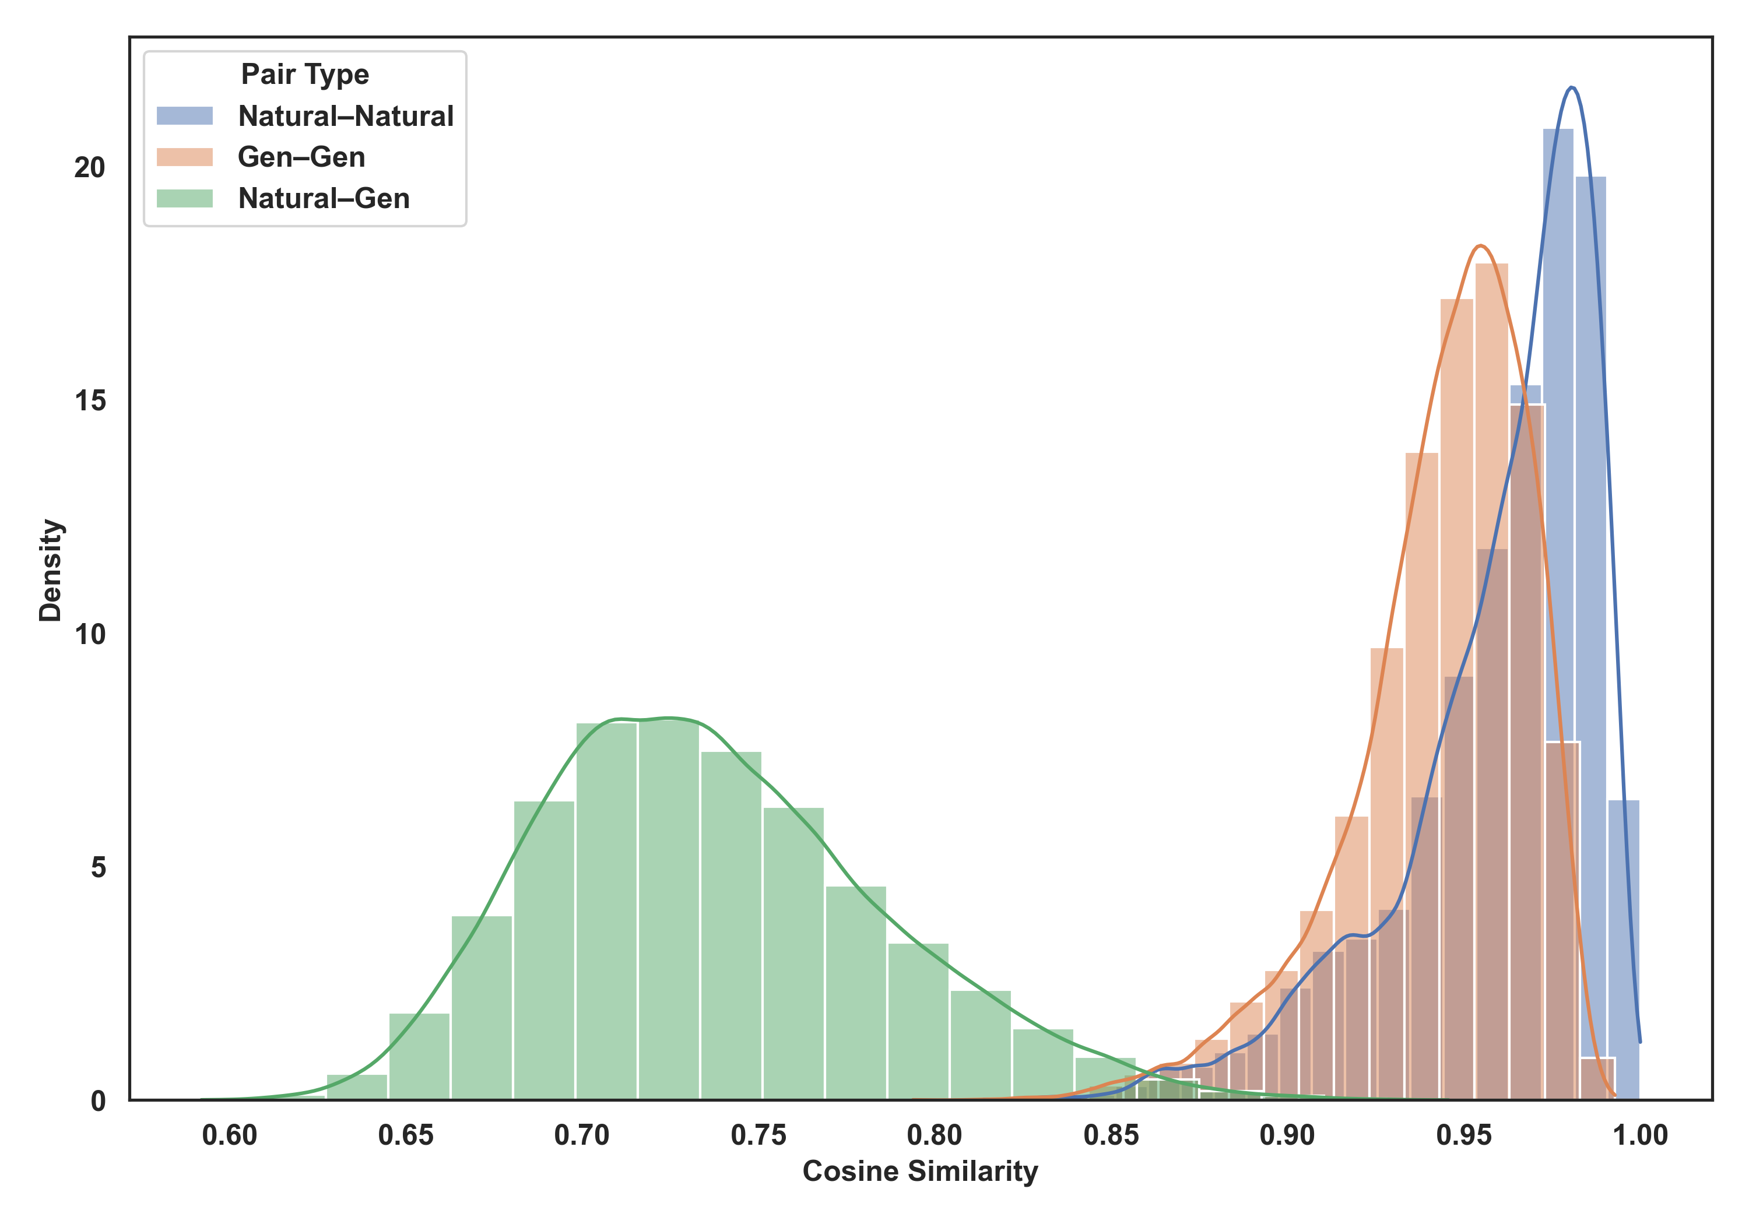
Figure 3. Cosine similarity between ESM2 embeddings of real and generated protein sequences. (Left) Cosine similarity heatmap between natural protein embeddings and those of StructDiff-generated sequences. The majority of generated embeddings exhibit moderate-to-high similarity (0.6–0.9) to multiple real sequences, indicating that the model explores plausible but non-trivial regions of protein latent space. (Right) Pairwise cosine similarity among generated protein embeddings. Despite class conditioning, the generated sequences maintain substantial diversity, with most pairwise similarities below 0.95. The diagonal reflects self-similarity (cosine = 1), while the surrounding structure shows the existence of sub-clusters within the generated set. Together, these results suggest that StructDiff samples latent representations that are biologically coherent yet non-redundant, balancing proximity to real protein families with generative novelty.
Figure 4. Latent space similarity between StructDiff-generated and natural protein embeddings. (Left) Cosine similarity heatmap comparing each generated embedding to natural protein embeddings using ESM2 latent representations. Most generated embeddings exhibit moderate-to-high similarity (0.6–0.9), indicating that StructDiff samples from semantically meaningful regions of protein space without collapsing to trivial reconstructions. (Right) Kernel density estimates of cosine similarity distributions for all pair types: natural–natural, generated–generated, and natural–generated. Natural–natural pairs form a sharp, high-similarity peak (mean ≈ 0.95), while generated–generated pairs are more broadly distributed (mean ≈ 0.89), suggesting diversity within generated samples. Natural–generated pairs exhibit a wider distribution skewed lower (mean ≈ 0.78), consistent with generation of novel, non-identical proteins. Together, these results confirm that StructDiff maintains a balance between biological plausibility and novelty in the learned latent space.

Slide 4
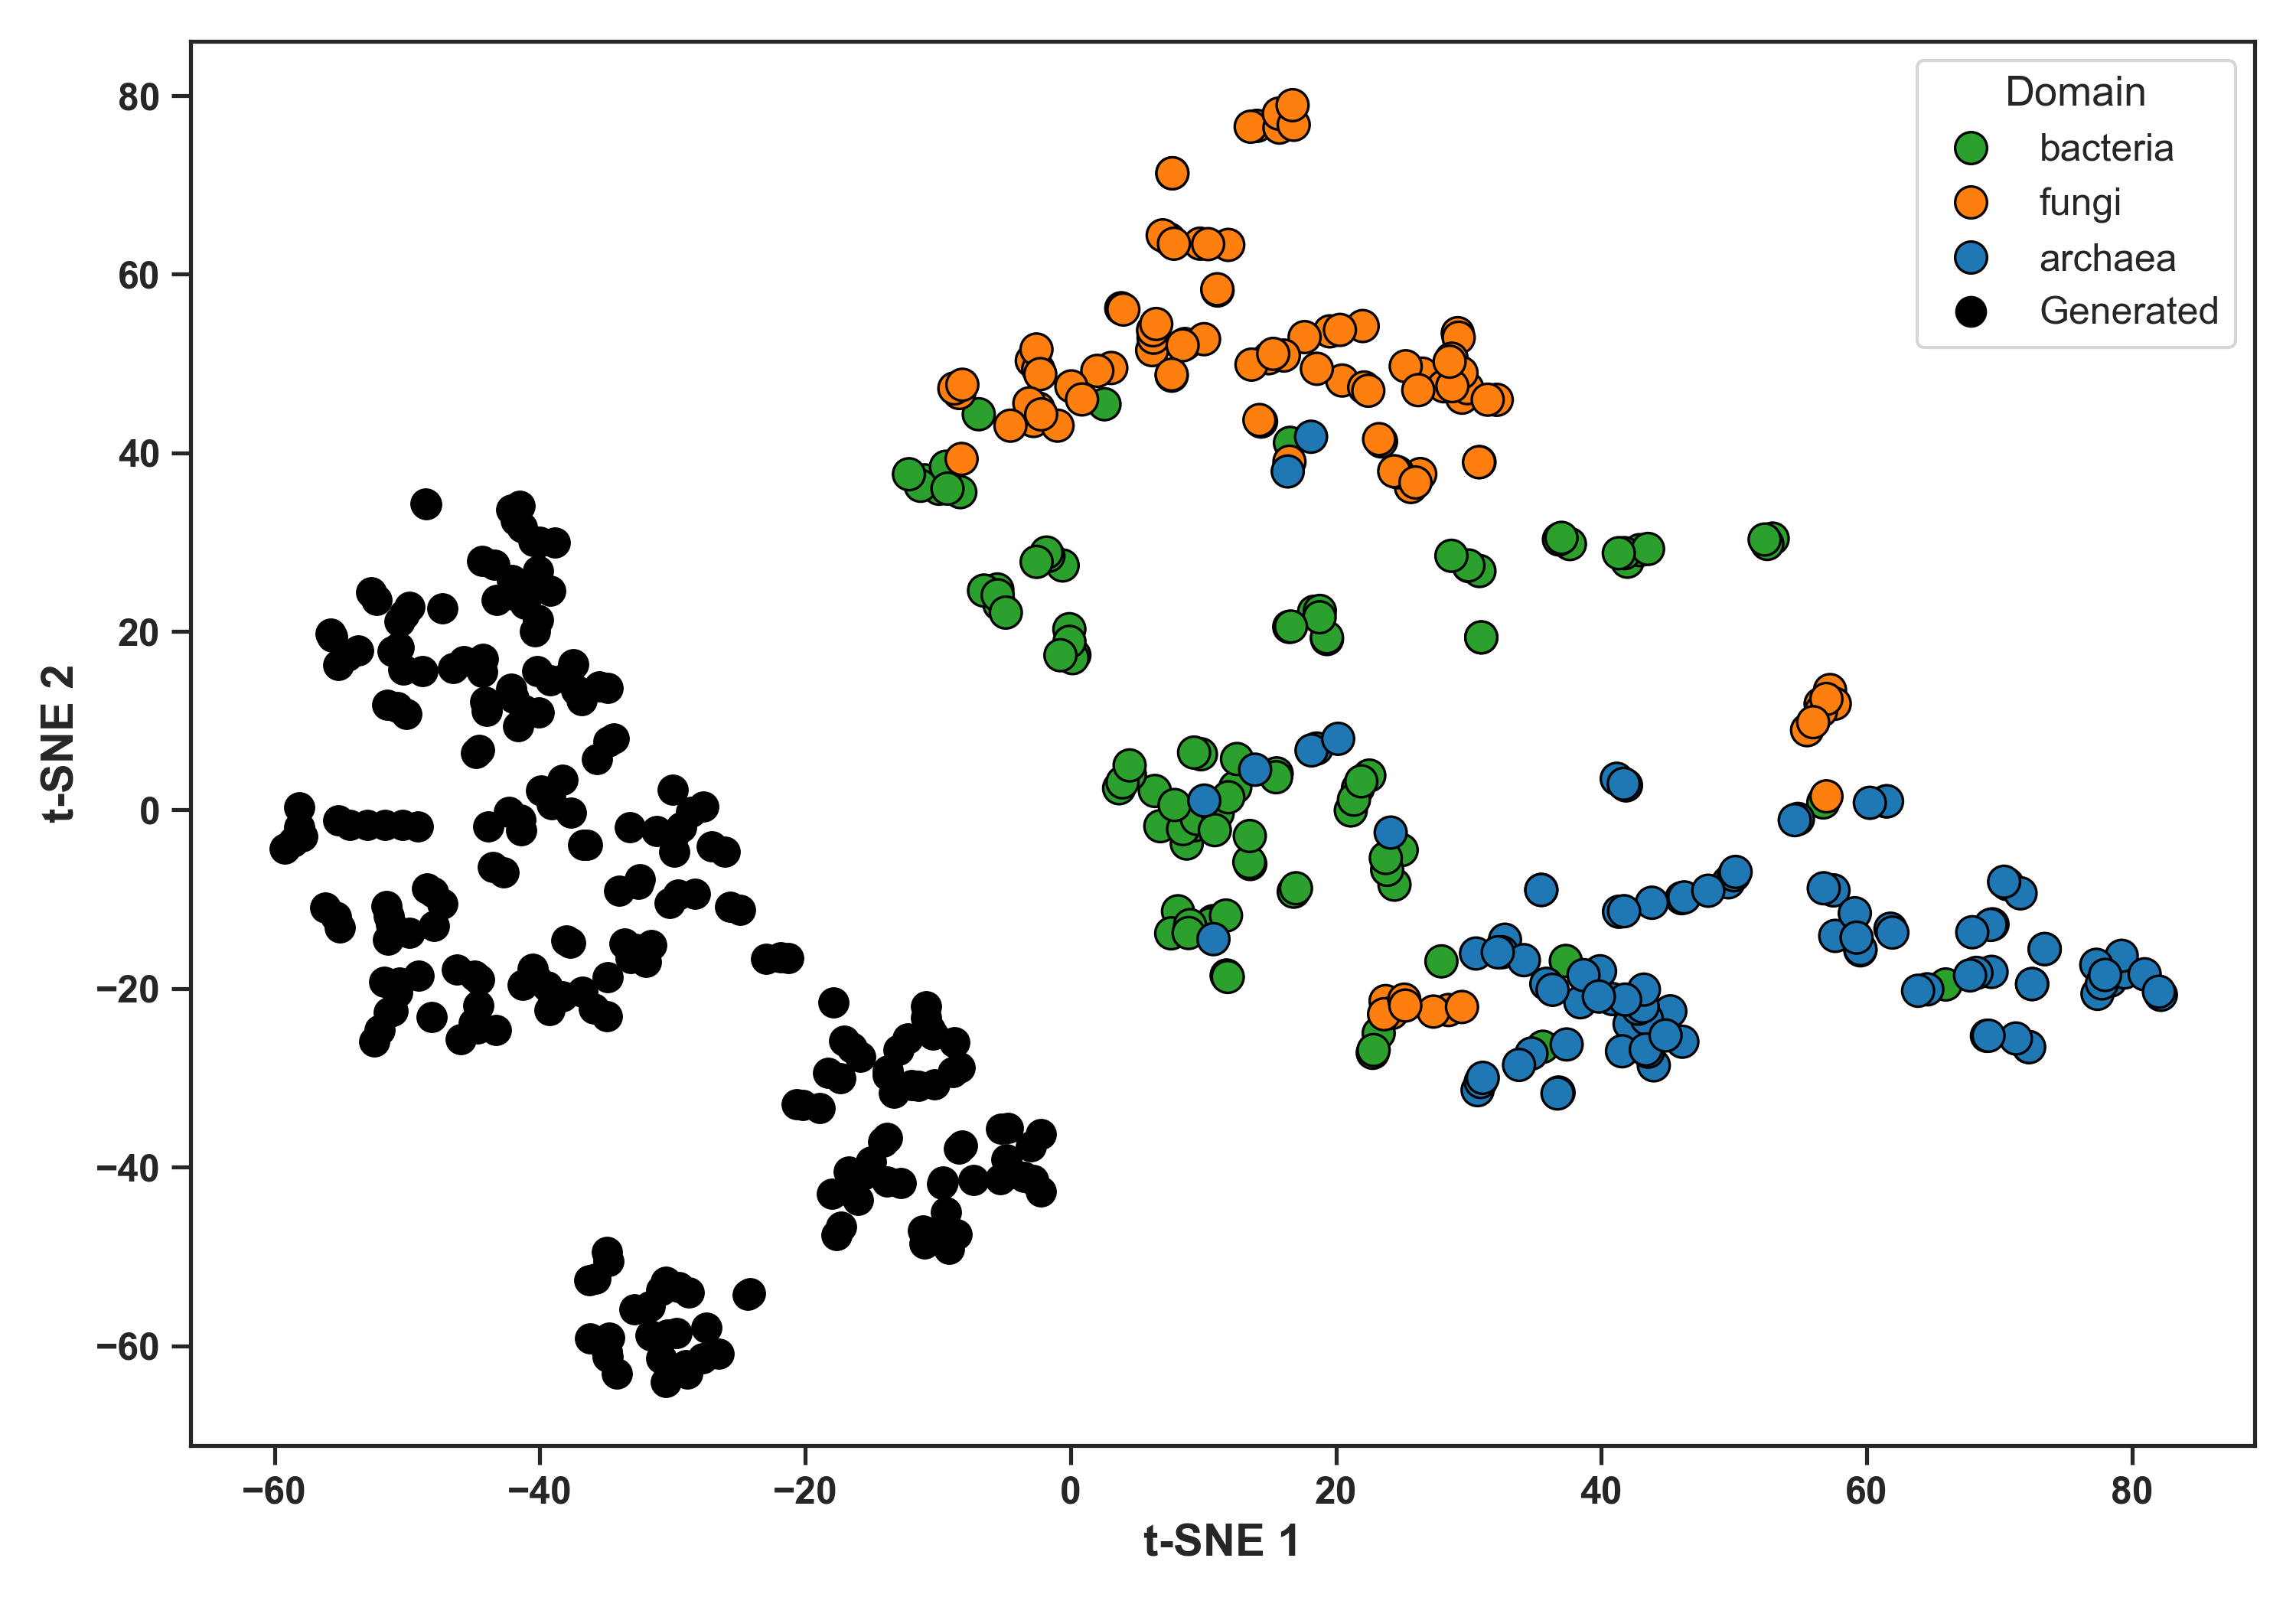
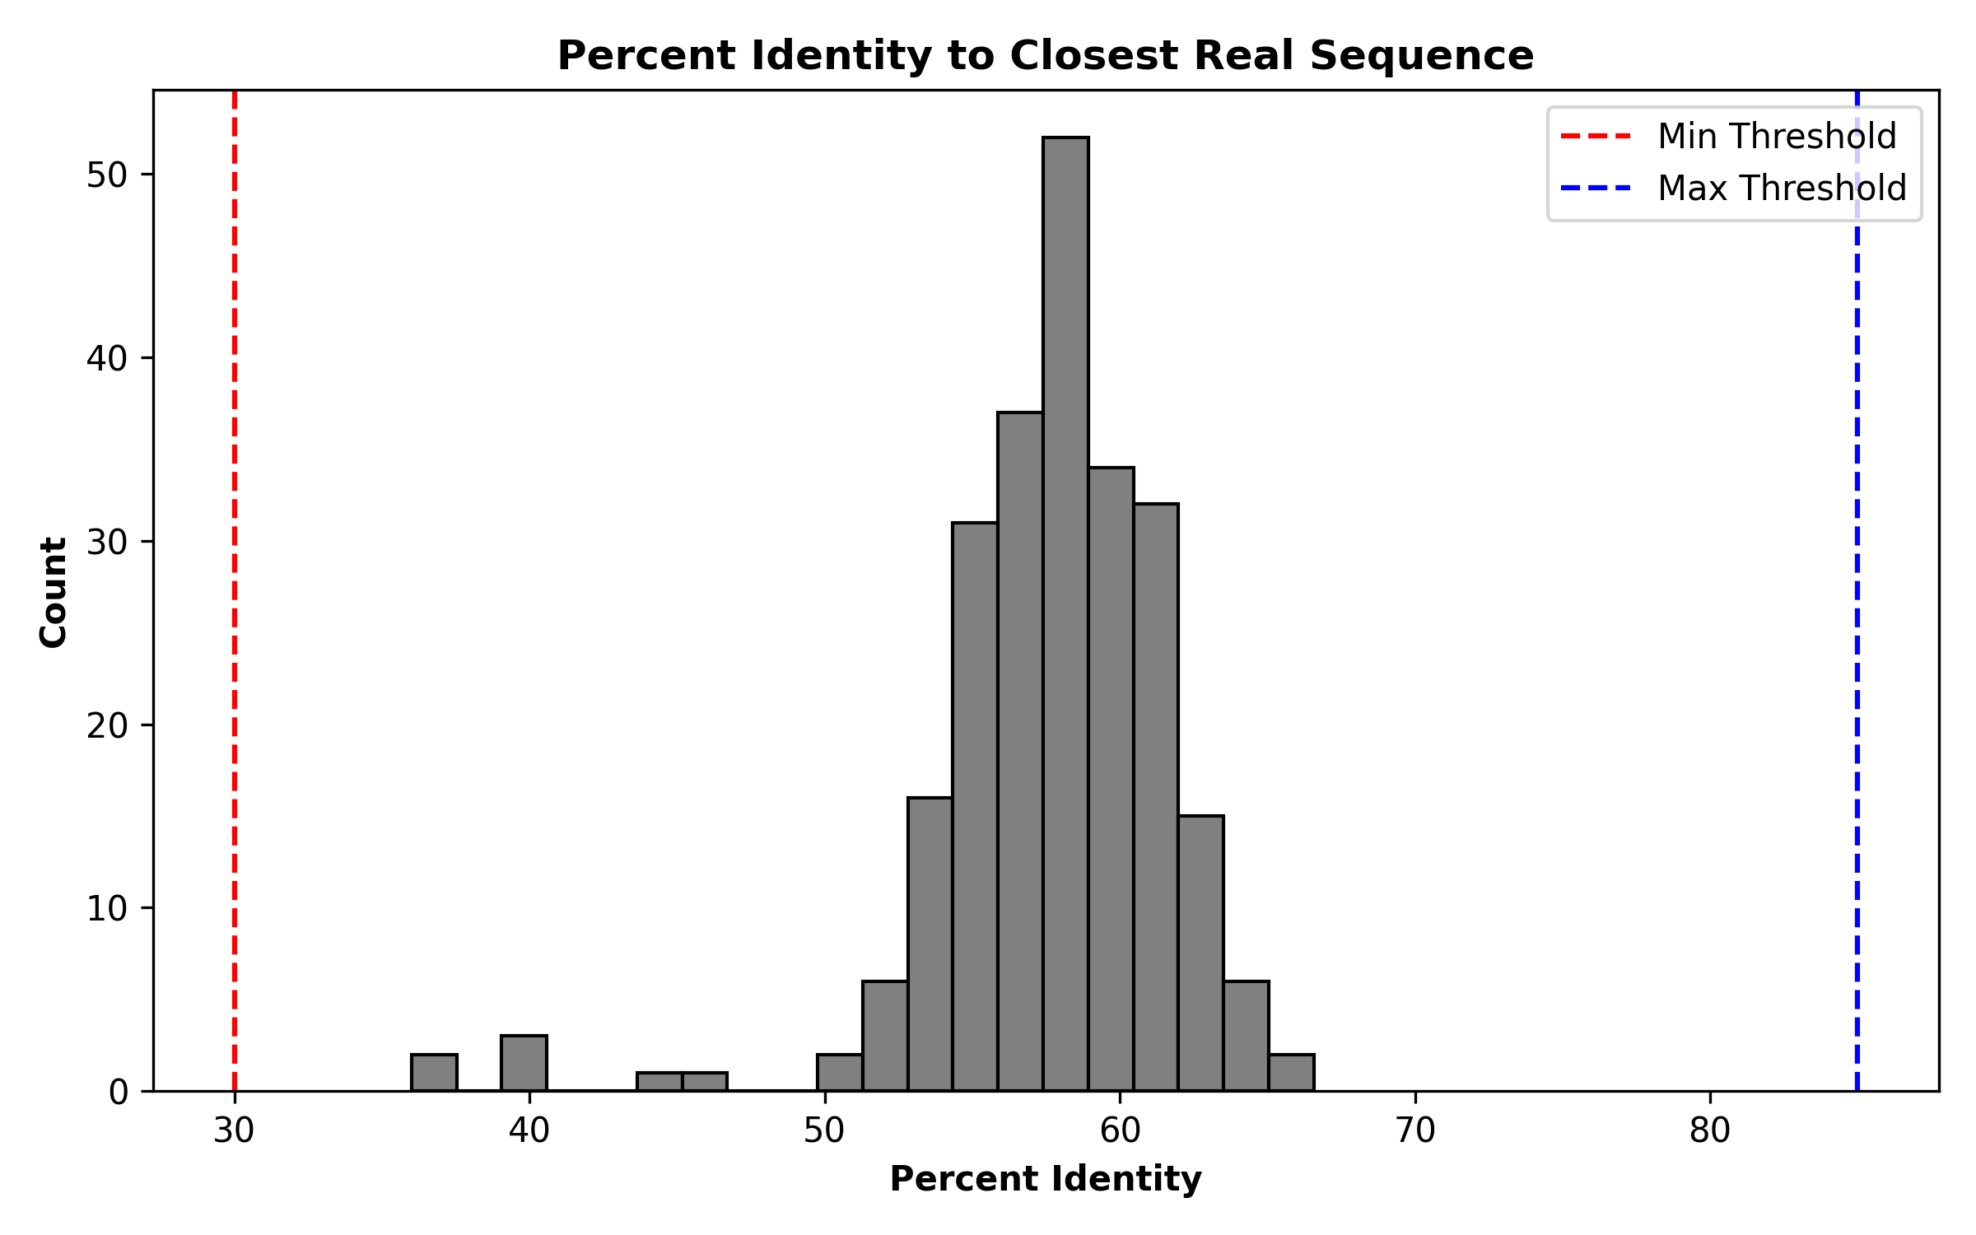
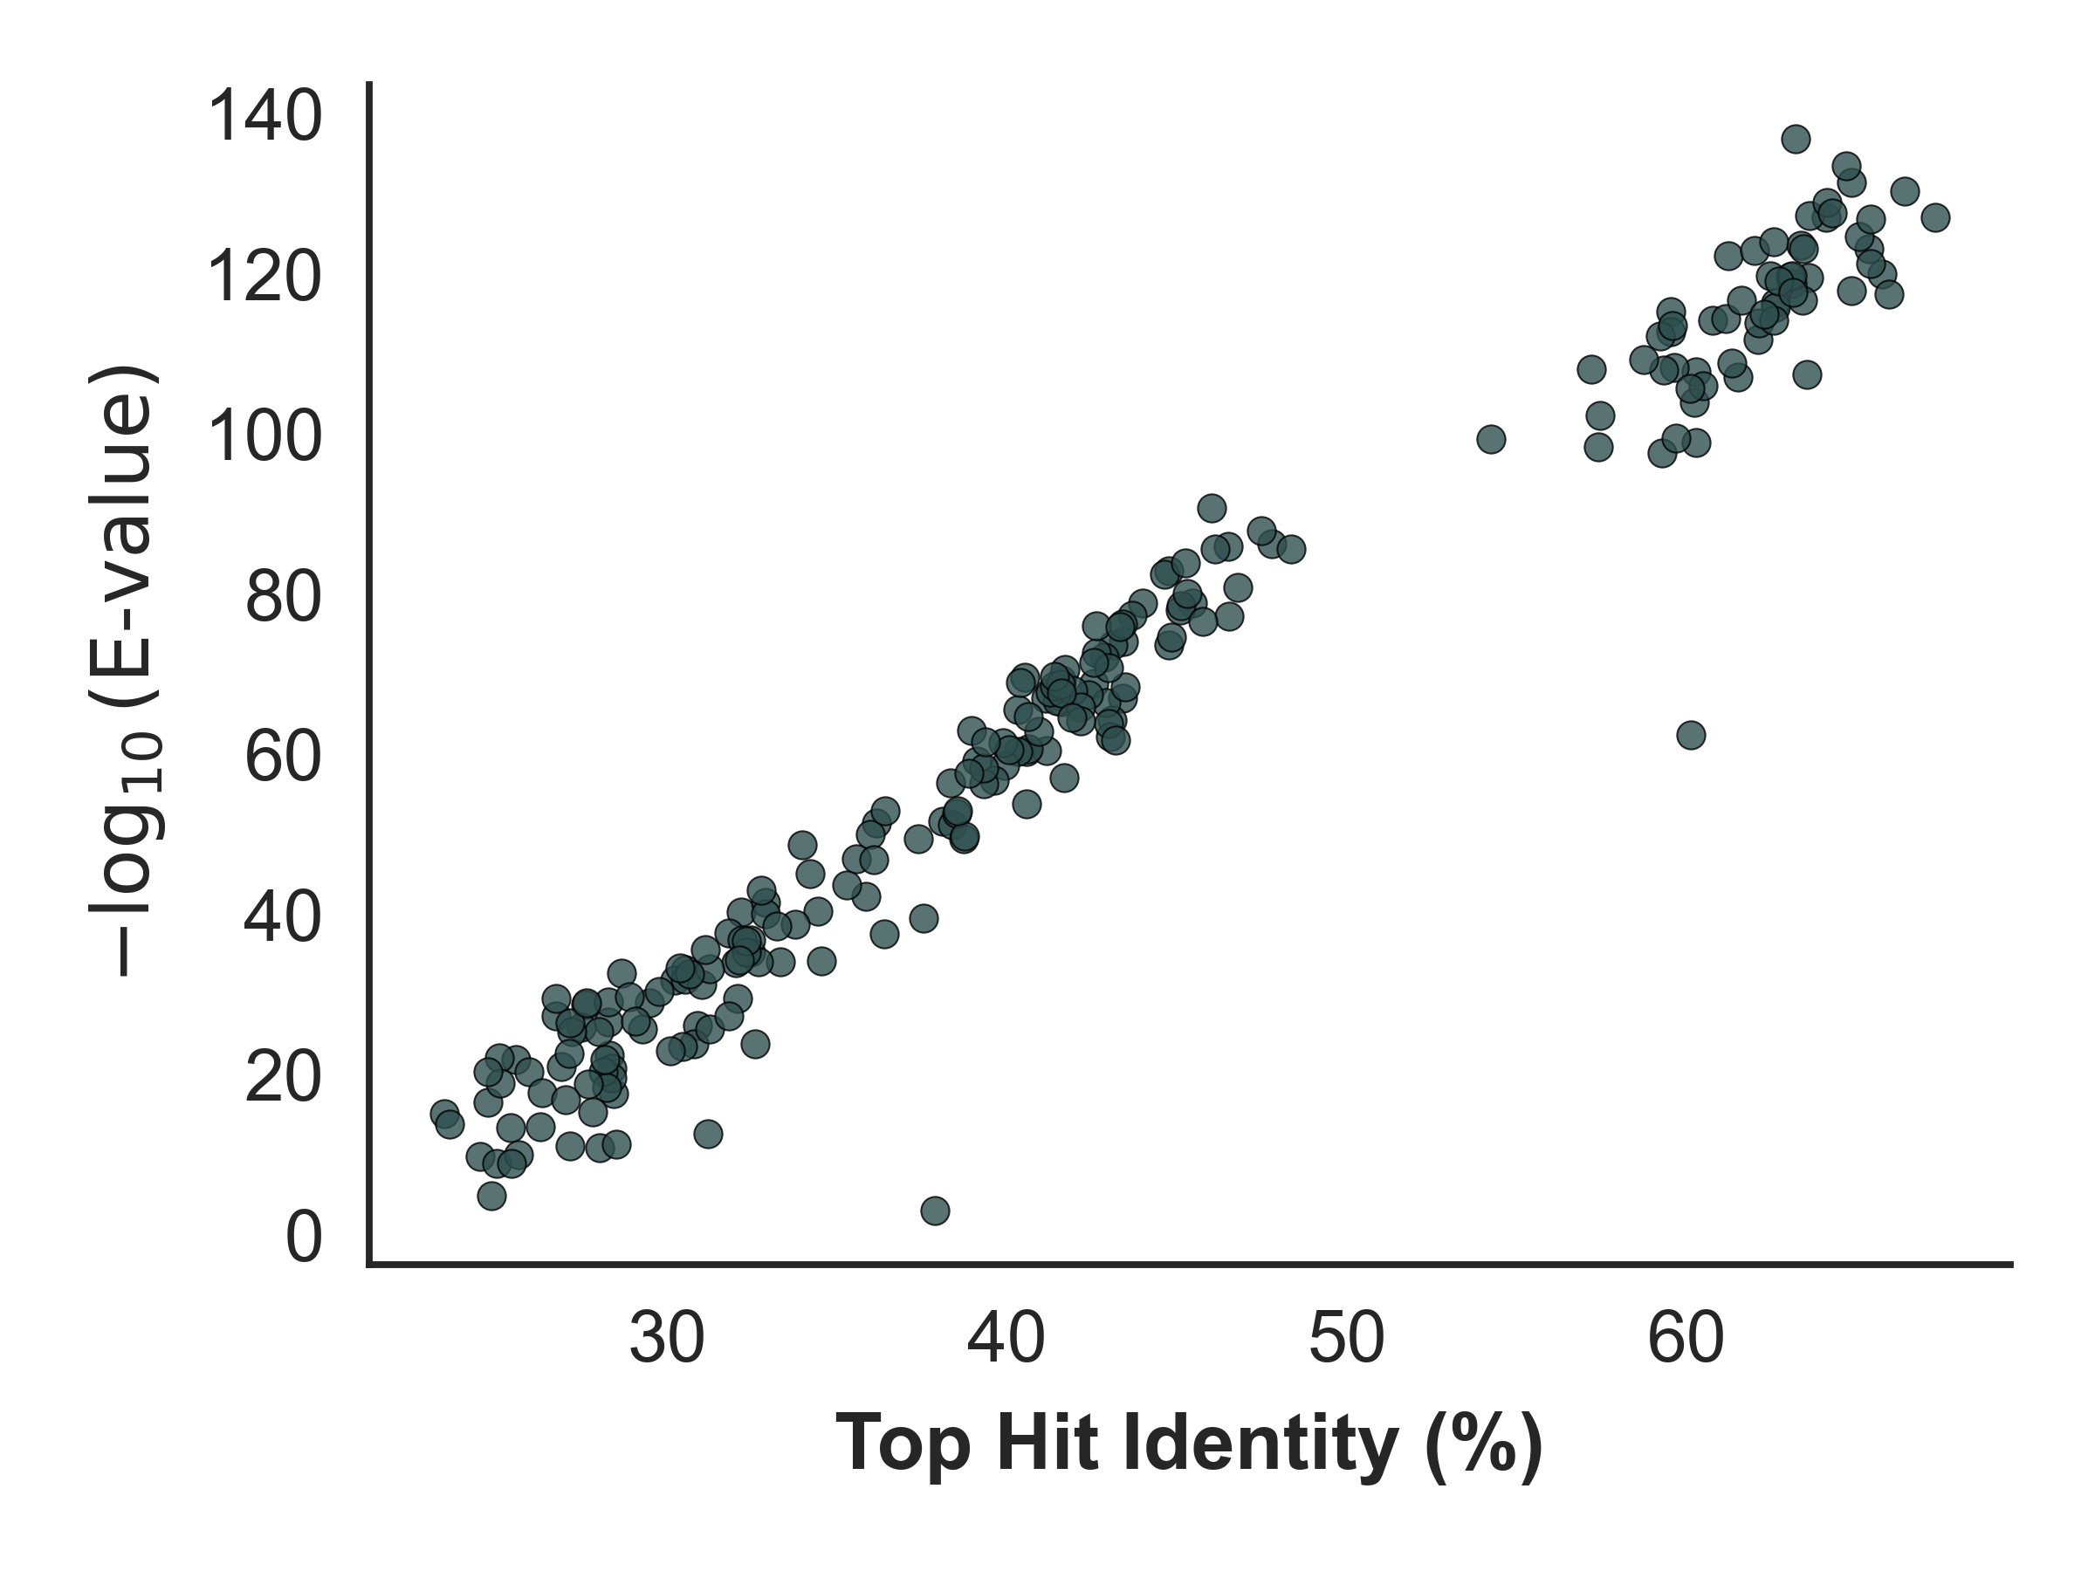
Figure 6. Evaluation of biological novelty and class consistency in StructDiff-generated protein sequences. (Top left) Histogram of percent identity between generated sequences and their closest natural sequence hit. The majority of generated sequences fall between 50–65% identity, with strict filtering applied to exclude sequences below 30% and above 85% identity (dashed lines). This range reflects the targeted balance between novelty and plausibility, ensuring sequences are neither trivial copies nor unrealistically divergent. (Top right) t-SNE visualization of ESM2 embeddings for natural sequences (colored by class) and EmbedtDiff-generated sequences (black). Generated sequences form a distinct but partially overlapping distribution near class-conditioned clusters, confirming that class information is retained in the embedding space while still generating novel, out-of-distribution candidates. (Bottom) BLAST Identity vs E-value Scatter Plot. Each point represents the top BLAST hit for a generated protein sequence. The x-axis shows sequence identity (%) to the closest known homolog, and the y-axis plots the statistical significance of that match as −log⁡10(E-value)-\log_{10}(\text{E-value})−log10​(E-value). Higher identity and lower E-values (higher −log⁡10-\log_{10}−log10​) suggest stronger evolutionary similarity.

Slide 7
Figure 1. Overview of the StructDiff pipeline for structure-aware protein sequence generation. StructDiff begins by embedding curated natural protein sequences using the pretrained ESM2 language model, which encodes each sequence into a fixed-length latent vector containing structural and evolutionary information. These embeddings are then used as input to a latent diffusion model that gradually adds Gaussian noise during training, and learns to denoise these vectors via a lightweight MLP. At inference, this process is reversed to generate new embeddings by iteratively removing noise from a random initialization.
The resulting denoised embeddings are passed through a separately trained autoregressive decoder—implemented as a Transformer or LSTM—which reconstructs biologically plausible amino acid sequences. Optionally, ESM2 logit distillation is used to improve decoder fidelity. Final sequences are filtered by identity and entropy to retain diversity while maintaining structure-relevant features. Structural plausibility is assessed using ESMFold, enabling generation of novel sequences with high foldability across protein classes.
Figure 1b. Evaluation pipeline for StructDiff-generated protein sequences. After decoding, generated protein sequences are assessed using a multi-faceted evaluation pipeline. This includes: (1) embedding-based similarity metrics (e.g., cosine similarity and t-SNE in ESM2 latent space) to quantify proximity to natural sequences; (2) structure-based evaluation using models like ESMFold to predict 3D folds and derive per-residue confidence scores (e.g., pLDDT); and (3) sequence-level comparison against known proteins using BLAST, enabling detection of homologous or novel variants. This integrative evaluation framework helps assess fidelity, diversity, and structural plausibility of generated proteins.

Slide 8
Figure 2b. Training and validation loss curves for the StructDiff denoising model. Mean squared error (MSE) loss is plotted over 300 training epochs for both the training set (blue) and validation set (orange). The raw loss curves are shown with light colors, while smoothed curves using a Gaussian filter are overlaid for clarity (green and red). The consistent downward trend across both sets indicates stable learning dynamics and effective noise denoising within the ESM2 embedding space. The StructDiff model learns to accurately reconstruct clean protein embeddings from noisy inputs, forming the basis for realistic generative sampling during inference. This training trajectory validates the suitability of diffusion modeling in latent protein space for structure-aware sequence generation.
Figure 2a. t-SNE projection of Natural protein embeddings by functional class. Natural protein sequences from three functional classes—kinases (green), beta-lactamases (orange), and serine proteases (blue)—were embedded using the pretrained ESM2 protein language model. These high-dimensional embeddings were projected into two dimensions using t-distributed stochastic neighbor embedding (t-SNE) for visualization. The resulting map reveals clear separation between protein classes, with distinct clusters corresponding to each functional group. This observation confirms that ESM2 embeddings capture biologically relevant signals that reflect evolutionary and functional relationships. These class-structured embeddings serve as the foundation for conditioning in the StructDiff generative framework, enabling targeted protein design within specific biological families.

Slide 9
Figure 6. Evaluation of biological novelty and class consistency in StructDiff-generated protein sequences. (Top left) Histogram of percent identity between generated sequences and their closest natural sequence hit. The majority of generated sequences fall between 50–65% identity, with strict filtering applied to exclude sequences below 30% and above 85% identity (dashed lines). This range reflects the targeted balance between novelty and plausibility, ensuring sequences are neither trivial copies nor unrealistically divergent. (Top right) t-SNE visualization of ESM2 embeddings for natural sequences (colored by class) and StructDiff-generated sequences (black). Generated sequences form a distinct but partially overlapping distribution near class-conditioned clusters, confirming that class information is retained in the embedding space while still generating novel, out-of-distribution candidates. (Bottom) Table of representative BLAST hits for StructDiff-generated sequences. A large proportion of generated sequences matched known proteins from related organisms with meaningful annotations, including kinases, serine proteases, and beta-lactamases. Sequence identities typically ranged from 55–62%, with E-values < 1e–70, indicating strong yet non-identical homology to natural proteins. These annotations demonstrate that StructDiff not only preserves latent biochemical signatures but also yields sequences that map to diverse, functionally annotated protein families.

Slide 10
Figure 5. Comparison of decoder architectures during training. (Top) Training and validation loss curves for the Transformer-based decoder trained on embedding–sequence pairs. The model converges quickly within the first 5 epochs, maintaining stable generalization with minimal train–val gap. (Bottom) Training and validation loss curves for the LSTM-based decoder. Loss decreases more gradually, and a persistent train–val gap indicates reduced generalization and lower model efficiency. These results support the use of Transformer decoders in StructDiff for faster convergence, lower final loss, and improved reconstruction quality.

Slide 11
Supplementary Figure 3a. t-SNE visualization of real and generated protein embeddings colored by class. Real protein embeddings from three classes — kinase (green), beta-lactamase (orange), and serine protease (blue) — are shown alongside generated embeddings (purple) sampled from the StructDiff model conditioned on each class. The generated points overlap with the manifold of their respective real classes, demonstrating class-conditional fidelity and structural consistency in the learned embedding space.

Slide 12
Figure 7. Structural validation of StructDiff-generated protein sequences using ESMFold. Predicted 3D structures for a representative set of generated sequences were computed using ESMFold, and visualized with pLDDT-based coloring to indicate per-residue confidence. Structurally distinct folds corresponding to three targeted protein classes—kinases, serine proteases, and beta-lactamases—are shown, illustrating the structural diversity captured by StructDiff. The predicted structures exhibit canonical class-specific features, such as α/β fold motifs in kinases and serine proteases, or extended β-sheet domains in β-lactamases.
Confidence coloring reveals high structural reliability, with most residues exceeding a pLDDT score of 70 (yellow to blue), and only terminal regions showing lower confidence. These predictions are consistent with properly folded globular proteins. Several novel topologies not directly found in the training set were also observed, suggesting that StructDiff is capable of exploring viable yet underrepresented regions of structural space.
Together, these results demonstrate that StructDiff-generated sequences are not only novel in sequence space, but also structurally valid with high predicted foldability. The structural outcomes provide strong evidence that generative modeling in the ESM2 latent space can yield realistic proteins across diverse families, supporting the model’s utility in structure-aware de novo protein design.

